Slide 1

Students:
VOTING
324763119 | Dmitry Gorelik | 1
336490347 | Anton Iosifov | 2
320821341 | Vladislav Liabouk | 3

Slide 2
Known bug
1. Survey for the candidates : Works differently.
Explanation : We preferred to leave politics out of the academic project therefor the survey is about fruit preference.
* We do not vote for the user’s best candidate by survey, but we do have a feature that shows candidate’s preference from the user point of view. Based on that view he can decide which one fits the most.
2.DataBase of the project built as local storage, most of our tables are in pop windows meaning it’s difficult to control those windows dynamically. Some tables need to be erased by button after the work is done and vote session is over, else they will be kept stored.

Slide 3

Detailed installation
Run Requirements:
Node JS should be installed and supported.
Ganache – Blockchain/Eth Ecosystem
MetaMask – Crypto Wallet/Browser Extension
All The project Files and modules. (Will be provided)
Ganache Setup:
Can be obtained at : https://archive.trufflesuite.com/ganache/
Create WorkSpace and add truffle.js as truffle project.
Server : 127.0.0.1
Port : 7545
Network ID: 5777
MetaMask Setup:
Can be obtained at any browser extension.
After register, Network should be configured manually.
Network Name : “Your input”
New Rpc URL: http://127.0.0.1 :7545
Chain ID: 1337
Currency : ETH

Slide 4
Detailed installation
Run Requirements Final Part:
After all the previous requirements are met, installed and configured.
We should find contract named Election.sol, at row 9 change admin public address.
1.1 Take any account of Ganache provided wallets, copy its public address and claim him to
be an admin.
Find 2_deploy_contracts.js at row 6 change the address to Admin’s address, we deploy some tokens
To Admin’s account for free use if needed.
3. After all those steps are done, open folder in compiler and run the following commands:
Truffle compile (compile the contract and check if everything went clear)
Truffle migrate –reset (migration, brand new start)
#After truffle migrate command output search for Token.Sol contract address and import this
Address in MetaMask as “import token”, do it for each of the accounts that are participating.
4. Start the server by command:
npm run dev
5. Login to MetaMask and refresh the page if needed.

Slide 5

Files and modules
1_initial_migration.js:
Truffle migration file for deploying the Migrations contract.
2_deploy_contracts.js:
Truffle migration file for deploying the Election and Token contracts. It also transfers
tokens to the Election contract after deployment.
app.js:
Client-side JavaScript file responsible for interacting with the deployed contracts. It establishes a connection to the blockchain, retrieves contract instances, and provides functionality for voting and administering the election process. It also handles event listeners for UI interactions.
index.html:
HTML file defining the structure of the web application. It includes elements for displaying election information, candidate lists, and voting interfaces. It also imports necessary JavaScript and CSS files.
CSS File:
bootstrap.min.css: CSS file containing styles for the Bootstrap framework, used to enhance the appearance and layout of the web application.
Custom-style.css: Responsible for styling.

Slide 6

Files and modules
Election Contract:
Stores information about candidates and voters.
Allows administrators to set the voting period and add candidates.
Basically, all the main functionalities in the blockchain and app.
Token Contract:
Implements the ERC20 token standard with basic simple functionality.
Migrations file:
contains migration scripts that Truffle uses for the automatic deployment of contracts
on the Ethereum network.
Else files:
Mostly generated by migration or other processes.

Slide 7


End-to-end Functionality
Only Admin Restrictions:
Admin accounts cannot perform a Vote.(Too much information provided for fair vote)
Admin can set the time for voting period. (Cannot add not logical time).
Admin can view election book.
Admin can add a candidate.
Admin clear the election book and preference table.
Admin can see in Real Time vote counts else hidden
Voter’s Address is stored in election book with AES encryption with secret word “Sparta”
Voter’s Address displayed only as substring from the real address that had been encrypted.
Voting Restrictions:
Vote cannot be casted if the period is not set or timed out. (Button Off and Contract will revert)
Each Account can vote only once.
Vote Count will be available for view only when the vote period is over and will be presented in table descending order, winner is 1st next to vote counter.
Each voter can view Candidate’s preferences and see if it fits him to cast a vote.
After vote performed VRT Token will be granted as a reward.

Slide 8
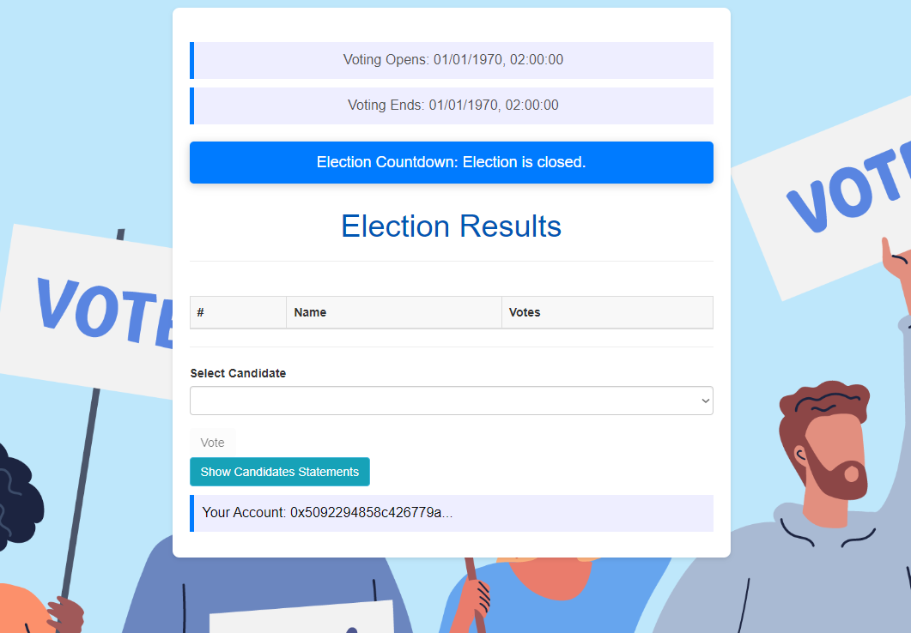
End-to-end example
Landing Page Default User:

Slide 9
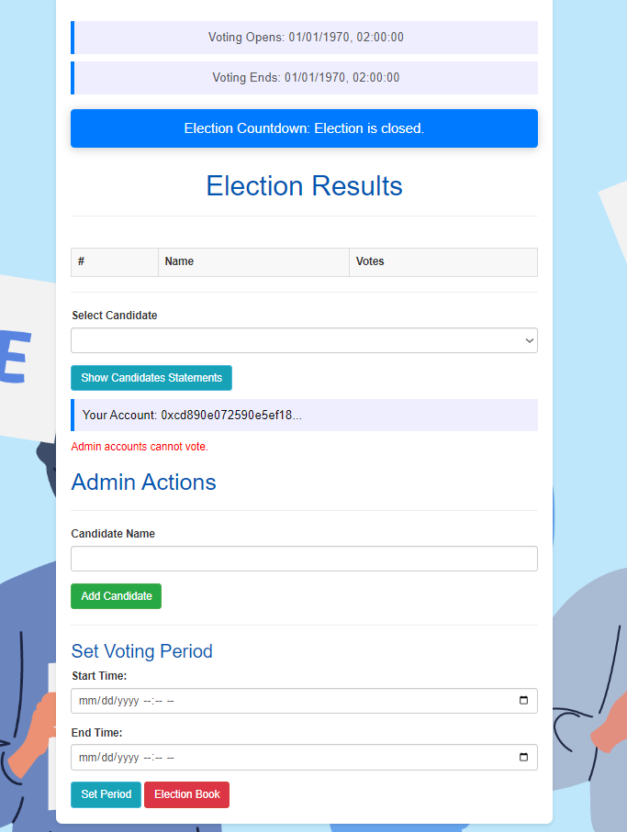
End-to-end example
Landing Page Admin (Choose Admin Acc MetaMask):

Slide 10
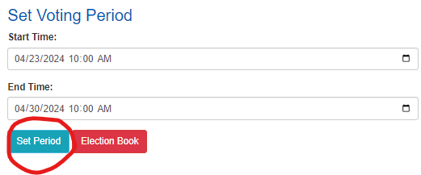
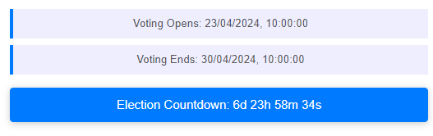
End-to-end example
Landing Page Admin (Set Time for Vote Perioud):
Approve the Transaction

Slide 11
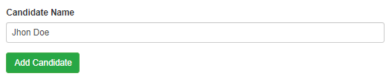
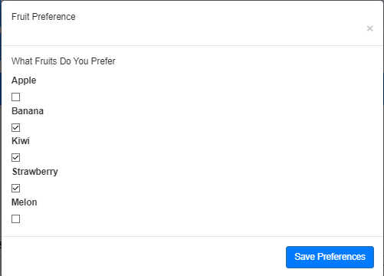
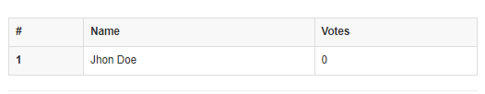
End-to-end example
Landing Page Admin (Add Candidate):
Fill The Form For Candidate:

Slide 12
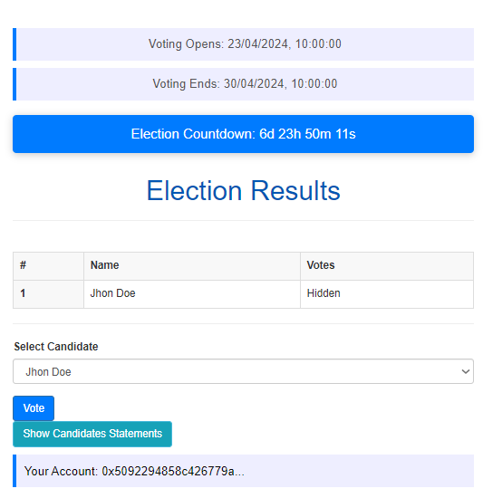
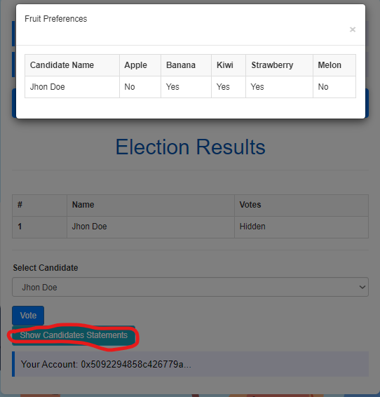
End-to-end example
Landing Page Default User (View Election + Watch Statements):

Slide 13
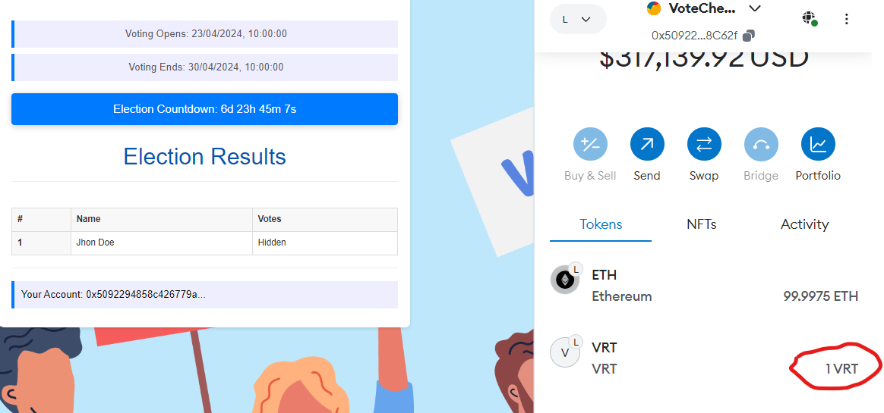
End-to-end example
Landing Page Default User (Cast Vote + Token Reward):

Slide 14
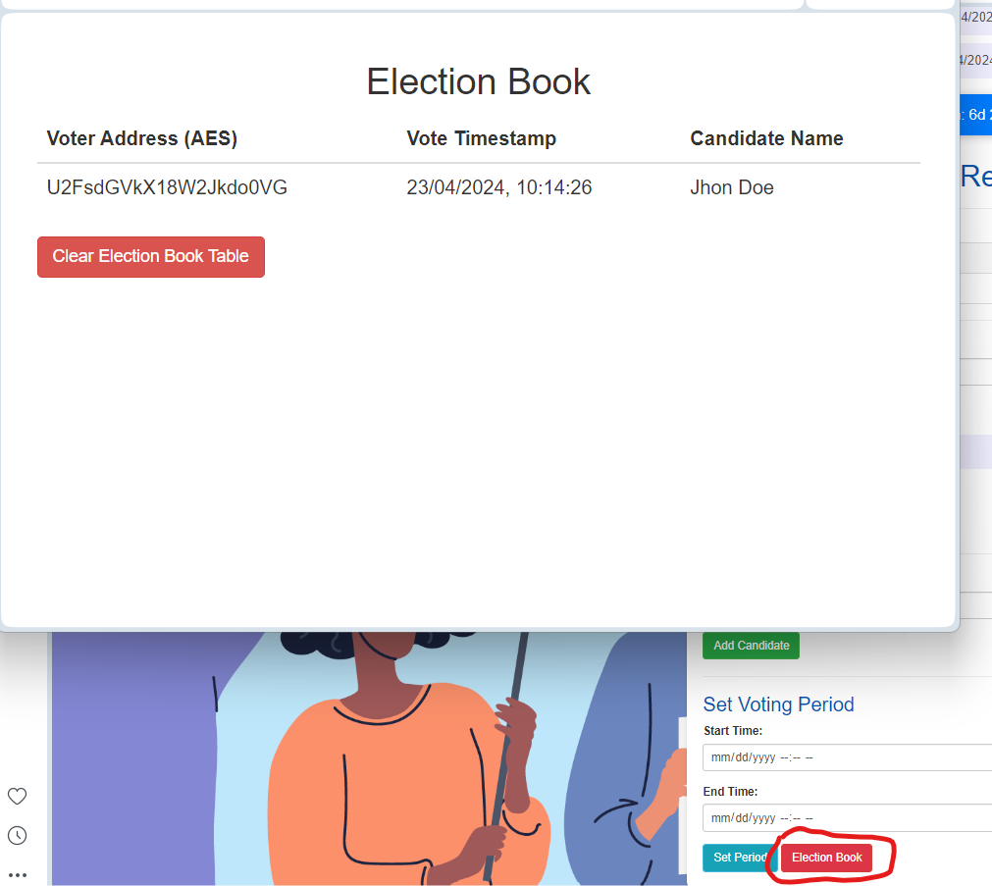
End-to-end example
Landing Page Admin(Election Book View AES Encrypt):

Slide 15
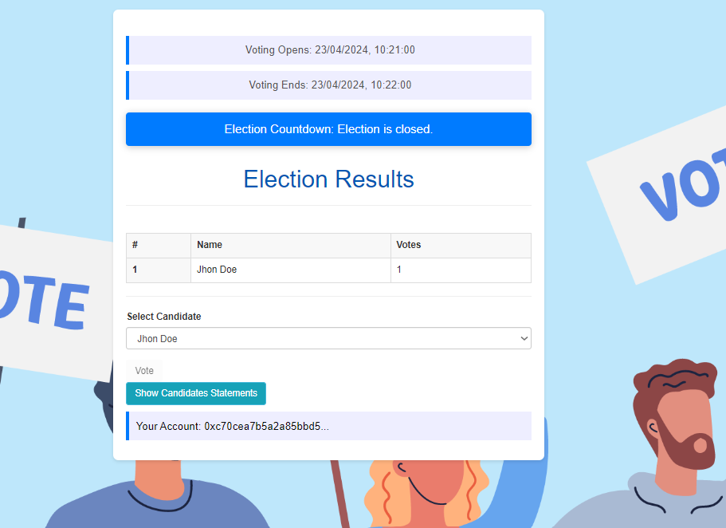
End-to-end example
Landing Page Default User Final Result:

